Slide 2

Renewable Energy Trends: Factors influencing the adoption of photovoltaic microgeneration technologies
Matthew Grady, Jacky Lu, Joseph Pillner, Owen Santoso, and Lachlan D Whang

Slide 4
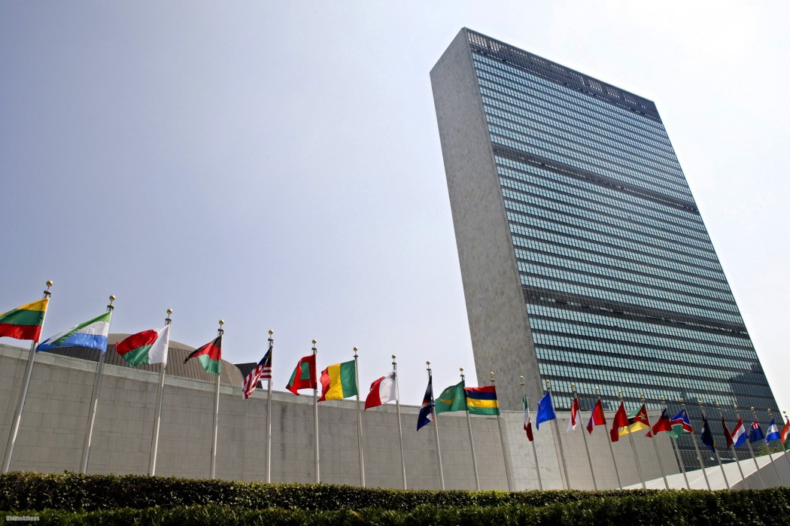
2015

Slide 5

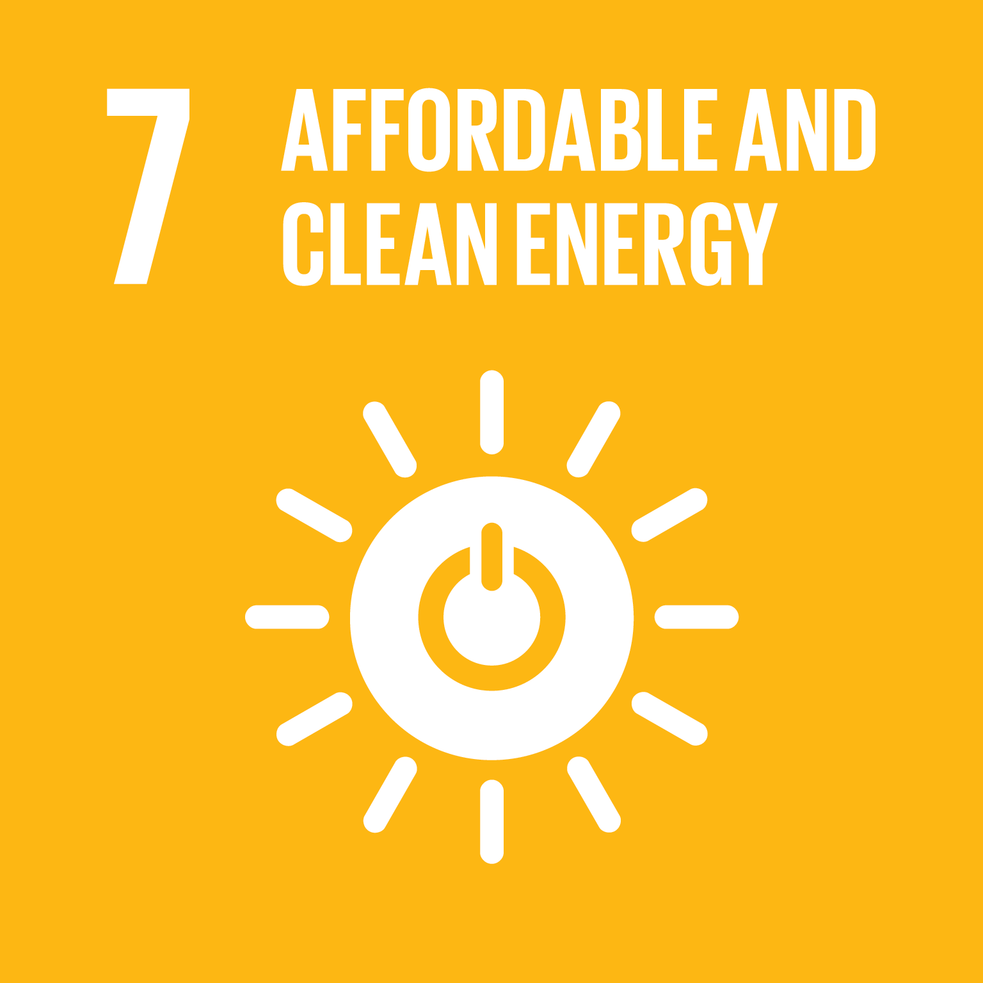

Slide 6
UN Goal 7: Ensure access to affordable, reliable, sustainable and modern energy for all
Notes:
- but how do we achieve this goal?

Slide 7
Renewable Energy
Solar Power

Slide 8
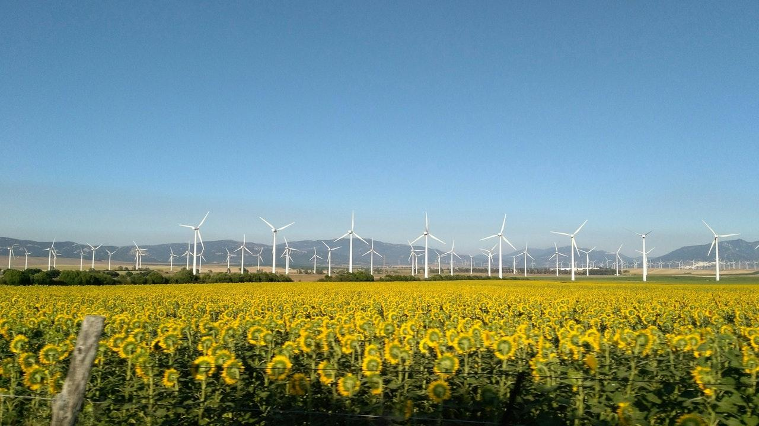
Renewable energy alternatives
Geothermal
Wind
Hydro
Biofuels
Natural gas
Notes:
Why solar energy over these other energies? - explain in speech

Slide 9
Why Solar?
Photovoltaic Cells are
Widely commercially available
Fairly reliable
Reasonably efficient
Most accessible for individual use
Already widely adopted

Slide 10
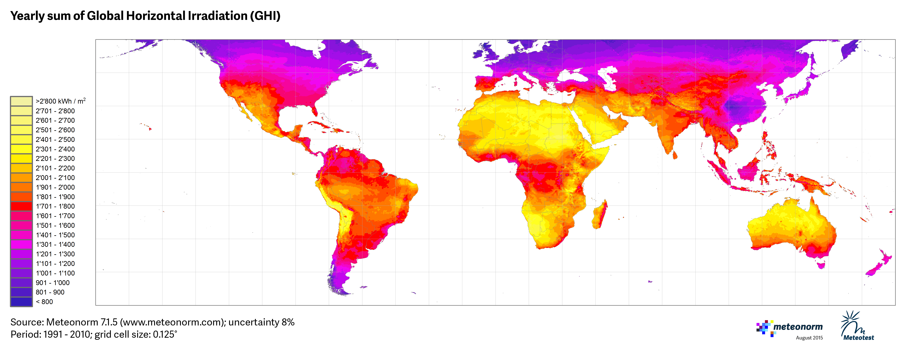

Slide 11
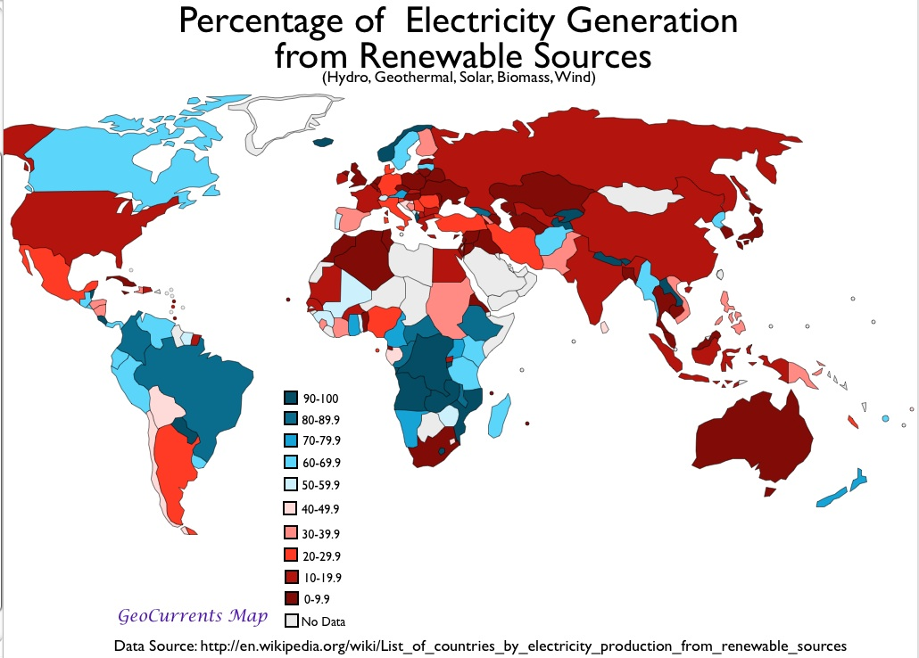

Slide 12
So what are the barriers or motivations?
Cost
Age
Identity
Personal
Social
Consumer Uncertainty
Awareness
Peer Effects
(Balcombe et al., 2013)
There is a large degree of heterogeneity in these factors
They are all interrelated
Makes it difficult to establish causation
(Willis, Scarpa, Gilroy & Hamza, 2011)
Notes:
Matthew

Slide 13

Gap in Knowledge What makes us different?
Lack of research in:
Australian context
Qualitative data
Contemporary data
Notes:
Matthew
How are we filling this

Slide 14
What makes us different?
We fill the gaps in existing research!
We look at the individual reasoning behind adoption of solar systems
We seek to identify the reason for the gap between intent and action
Notes:
Matthew
Aus
Focus on WHY, and the individual, more than just demographics

Slide 15
Aim for our research Our research seeks to:
Identify barriers to solar system adoption
Determine the extent of these barriers
Rationalize the causation behind these factors
Notes:
Matthew

Slide 16
RESEARCH
METHODOLOGY

Slide 17

Research Process
Survey Homeowners
Conduct Interviews
Analyse Data
Notes:
Plz remove the subtitle ;D

Slide 18
FIRST
PHASE

Slide 19

Postal Survey
Homeowners
Less careless responses (Ward et. al, 2017)
Easier to distribute to large target audience

Slide 20
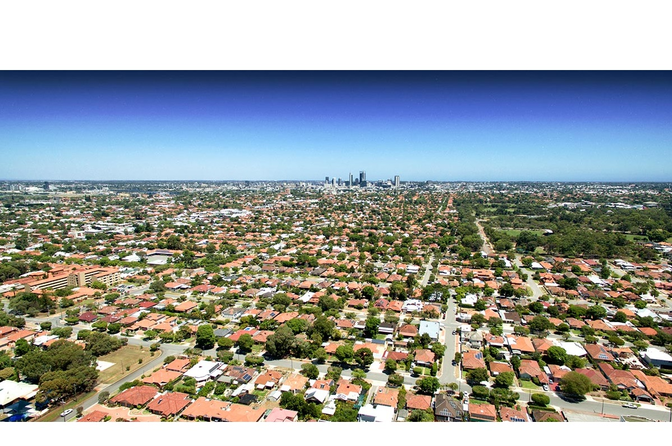
Suburb Selection
Geographic Location
Median Age
Index of Relative Socio-economic Advantage and Disadvantage (Australian Bureau of Statistics, 2018)

Slide 21
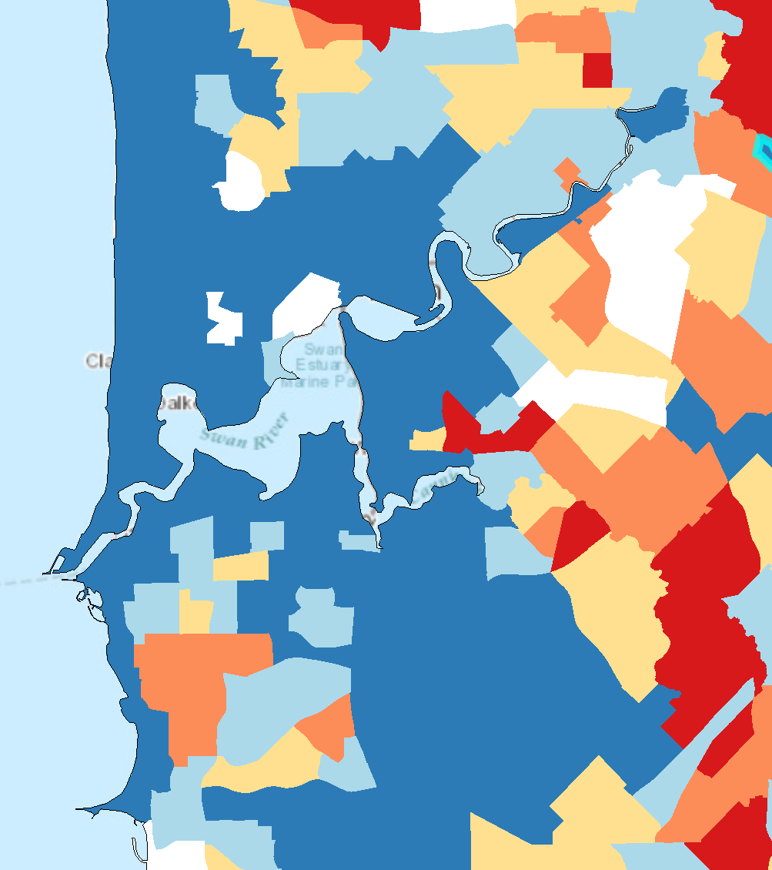
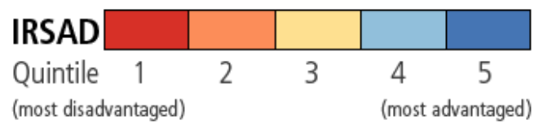
Embleton
IRSAD: 54th Percentile
Median Age: 37
Maylands
IRSAD: 77th Percentile
Median Age: 34
Spearwood
IRSAD: 37th Percentile
Median Age: 41
IRSAD: Index of Relative Socio-economic Advantage and Disadvantage

Slide 22

Introductory Questions
Age
Household income
Type of home
Standard of education

Slide 23
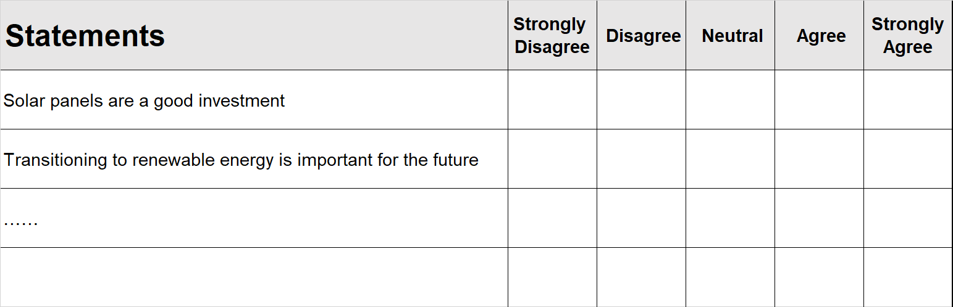
Likert Scale Questionnaire
SAMPLE

Slide 24

Likert Scale
Used by recent study in Nigeria (Nwokocha, Okoro & Usoh, 2018)
Latent Class Analysis
Classify into mutually exclusive groups
Trends between socio-economic factors and willingness
Help us find the motivators for installing solar power
Crucial for second phase
Notes:
Matthew
Aus
Focus on WHY, and the individual, more than just demographics

Slide 25
SECOND
PHASE

Slide 26
SECOND PHASE
Determining Barriers for Adoption
"younger age groups typically... are more willing to consider installing but less frequently reach the point of installation" - Balcombe et al. 2013, pg. 664
“there has been little research into why adoption is lower for different segments of the population and the…barriers that affect adoption .” - Balcombe et al. 2013, pg. 664

Slide 27
Future work is needed to shed light on people’s in-depth knowledge about the importance of … renewable energy technology and we need to consider all variables related to social acceptability of renewable energy.”
- Moula et al. 2013, pg. 97

Slide 28


THE APPROACH
(Qualitative)
WHO?
HOW?
INTERVIEW
Already have technology
Unwilling to uptake tech
Willing to adopt technology

Slide 29
Thematic Analysis
A method for identifying, analysing, and reporting patterns (themes) within data.
Financial difficulties
Lack of awareness of energy benefits
Lack of concern for environment
Hassle concern

Slide 31
Ethical Implications
Participation
Private Data
How do we handle these issues?
Notes:
Speech notes:
"It will then allow us to relay to suppliers (and others) what aspects to address to better increase consumer demand; whether it be better education of benefits or an adjustment in its application process. "

Slide 32
Significance
Current Energy Situation
60% of Greenhouse Gas – Consumer Use (International Energy Agency, 2015)
A Multitude of Reasons
Why are our results significant?
Consumer patterns and adaptation of schemes

Slide 33
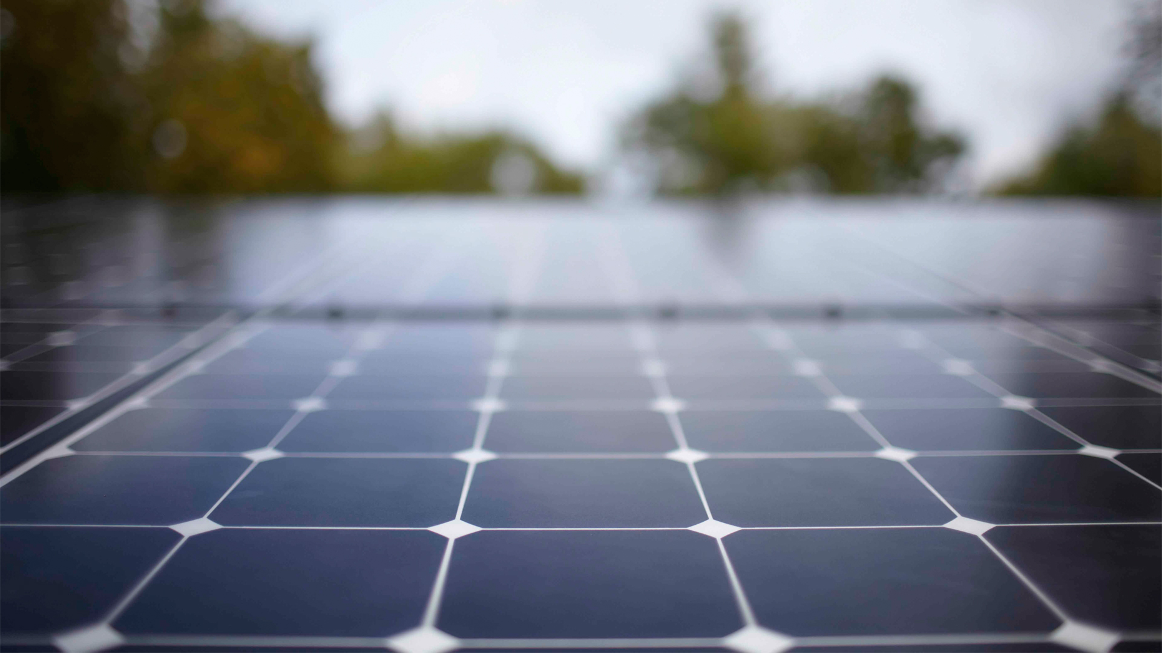
The time is now.

Slide 34
References
2033.0.55.001 - Census of Population and Housing: Socio-Economic Indexes for Areas (SEIFA), Australia, 2016. (2016). Abs.gov.au. Retrieved 2 May 2018, from http://www.abs.gov.au/ausstats/abs@.nsf/Lookup/by%20Subject/2033.0.55.001~2016~Main%20Features~IRSAD%20Interactive%20Map~16
Balcombe, P., Rigby, D., & Azapagic, A. (2013). Motivations and barriers associated with adopting microgeneration energy technologies in the UK. Renewable And Sustainable Energy Reviews, 22, 655-666.
Sommerfeld, J., Buys, L., Mengersen, K., & Vine, D. (2017). Influence of demographic variables on uptake of domestic solar photovoltaic technology. Renewable And Sustainable Energy Reviews, 67, 315-323.
Nwokocha, C., Okoro, U., & Usoh, C. (2018). Photovoltaics in Nigeria – Awareness, attitude and expected benefit based on a qualitative survey across regions. Renewable Energy, 116(PA), 176–182. doi:10.1016/j.renene
Ward, M., Meade, A., Allred, C., Pappalardo, G., & Stoughton, J. (2017). Careless response and attrition as sources of bias in online survey assessments of personality traits and performance. Computers in Human Behavior, 76, 417–430. doi:10.1016/j.chb.2017.06.032.2017.09.070
Meteotest (2015). World – Yearly sum of Direct Normal Irradiation (DNI)(1991-2010), grid cells: 0.125° [image]. Retrieved from: http://www.meteonorm.com/images/uploads/demo_uploads/dni_v715_hr.png
International Energy Agency (2015). Energy and Climate Change 2015. Retrieved from: https://www.iea.org/publications/freepublications/publication/WEO2015SpecialReportonEnergyandClimateChange.pdf
E. Moula, M., Maula, J., Hamdy, M., Fang, T., Jung, N., & Lahdelma, R. (2013). Researching social acceptability of renewable energy technologies in Finland. International Journal Of Sustainable Built Environment, 2(1), 89-98.

